Slide 1




SkillBridge
Client-Server Based
Skill Gap Analysis System
Java-based project
Client-Server Architecture
Multithreading
TEAM MEMBERS
Swati, Vidhi, Paritosh
INSTITUTION
Graphic Era Deemed to be University

Slide 2


Introduction
SkillBridge is a client-server based platform for career guidance and skill gap analysis.
Compares current student skills with career requirements
Identifies missing or weak skills
Calculates skill match percentage
Provides personalized improvement recommendations
Supports multiple users via client-server architecture

Slide 3


Problem Statement
Students struggle to understand what skills careers really require
Hard to know which skills they are missing for their target roles
Every career demands a different set of skills
Manual comparison of skills is time-consuming and complex
Students need a simple, fast, personalized system that quickly identifies skill gaps

Slide 4












Proposed Solution
SkillBridge analyzes your skills and career goals to identify gaps and deliver a clear path forward.
01
02
03
04
05
06
You enter your existing skills and select your target career
SkillBridge retrieves the required skills for your chosen career
The system compares your current skills with the required skills
It identifies missing skills and highlights the gaps
SkillBridge calculates your skill match percentage
You receive a personalized Skill Gap Report with recommendations
Clear insights. Measurable match. Personalized recommendations.

Slide 5




Objectives
Identify students' existing skills accurately
Analyze career-specific skill requirements
Detect missing or weak skills
Claculate skill match percentage precisely
Provide personalized improvement suggestions
Support multiple clients with multithreading
Enhance students’ career readiness

Slide 6
















System Architecture
Client–server design enabling concurrent skill gap analysis
Client
Provides an intuitive interface for input and result display
Client 1
Server
User interface for input and results
Receives requests, processes data, and performs skill comparisons
Server
Skill Analysis
Handles requests, processes data, and performs skill comparisons
Client 2
Compares current skills with career requirements
User interface for input and results
Multithreading
Separate thread per client for simultaneous processing
Multithreading
Client 3
User interface for input and results
Dedicated thread per client enables multiple users at the same time

Slide 7











Working / System Flow
Skills
Career
Server
Analysis
Result
open SkillBridge and enter profile
select target career
client sends data to server
compare skills and calculate match
send recommendations back to client
input current skills
server creates and uses thread
identify missing skills
Example
Current Skills
Career
Missing Skills
Java, HTML, Excel
Data Analyst
SQL, Power BI, Statistics

Slide 8



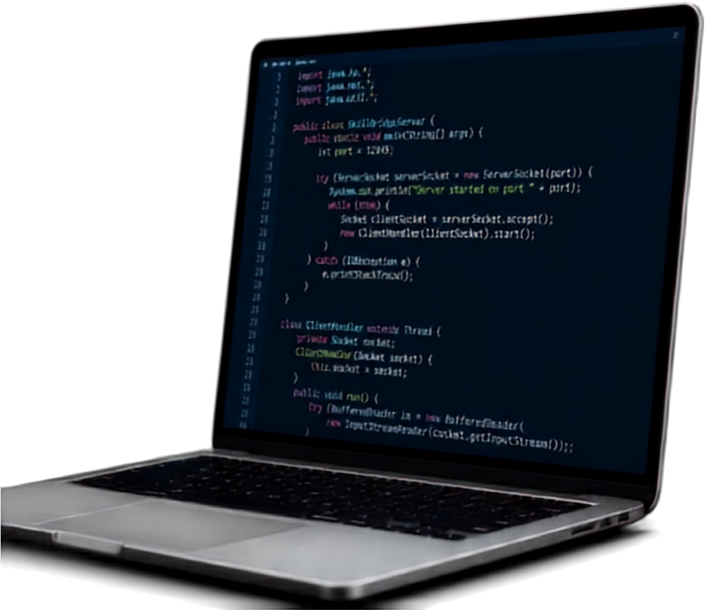







Technologies & Modules
TECHNOLOGIES
KEY MODULES
Java
Login / User Profile
Skill Input
Java
Socket Programming
Career Selection
Client
Architecture
Skill Database
Skill Gap Analysis
Multithreading
Match Percentage Calculation
GUI
Frontend
Recommendations
MySQL
Client-Server Communication

Slide 9







Team Roles & Expected Output
Frontend & UI/UX
EXPECTED OUTPUT
Swati
Builds user interface, input screens, career selection, result display, recommendations, and frontend integration
Skill Match Percentage
Client & Database
Existing Skills
Vidhi
Manages client communication, data exchange, database management, and student/career data
Missing Skills
Recommended Skills
Server & Multithreading
Paritosh
Handles server coding, socket handling, multitreading, and skill analysis logic
Career Readiness Report

Slide 10




Future Scope & Conclusion
WHAT’S NEXT
AI-driven skill recommendations
Resume skill analysis integration
Course recommendations based on gaps
Job-market skill trend analysis
Personalized learning roadmap
Progress tracking and job matching
THE IMPACT
Personalized skill-gap analysis system
Helps students understand career requirements clearly
Supports multiple users simultaneously
Demonstrates Java networking and multitreading
Empowers better career decisions
Thank You

